Slide 1
Nuclear Fuel Performance
NE 591

Slide 2
Last Time
Mining -> Processing -> Conversion -> Enrichment -> Powder -> Compaction/Sintering -> Rod/Assembly
U₃O₈ must be converted to UF₆ for enrichment, which is then converted to UO₂ powder for pellet manufacture
For different fuel types, enriched UF₆ follows a different path

Slide 3
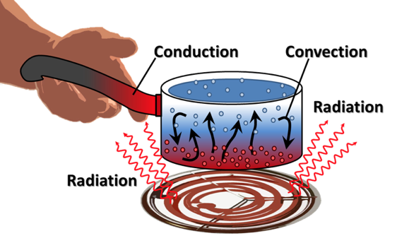
Last Time
General heat transport
Heat is produced in the fuel, transports through the gap and cladding, and into the coolant
The geometry of our problem
The initial condition of T
The boundary conditions of T
Is each parameter is a function of T
Thermal conductivity, heat capacity
Function of space/time?
Heat generation, dependent upon flux

Slide 4
Analytical solve of heat conduction

Slide 5
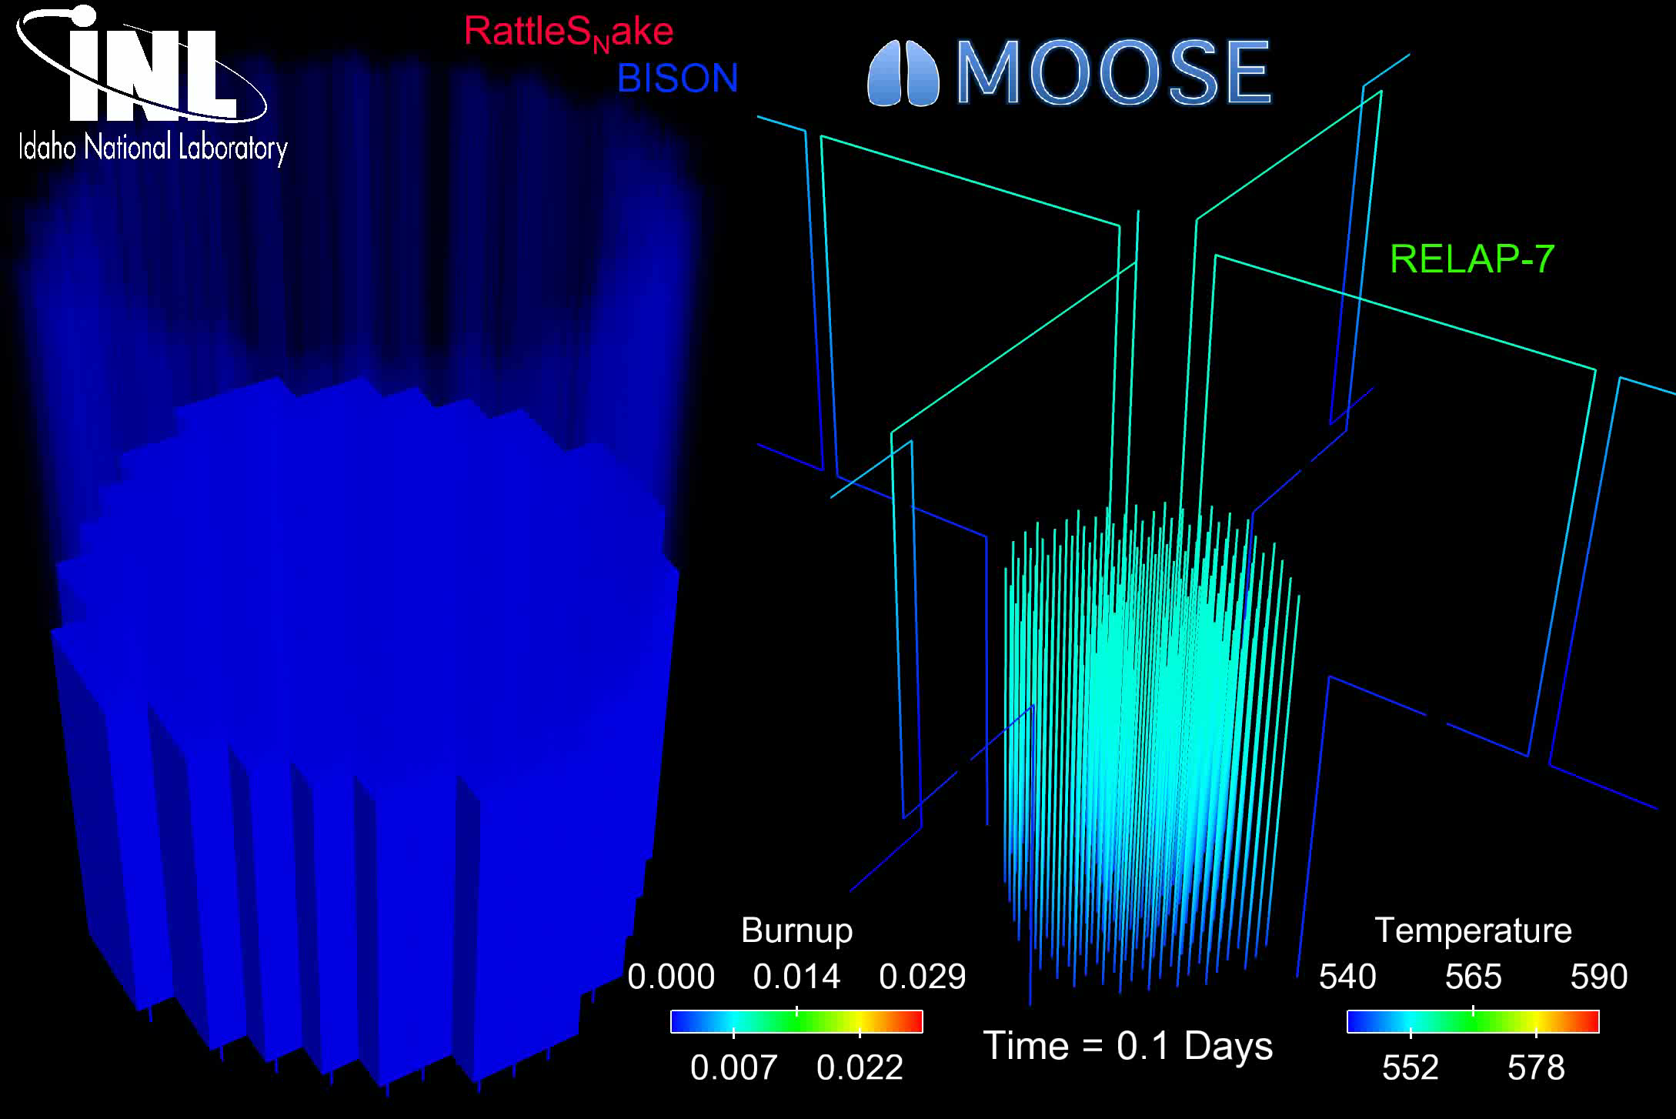
The most accurate solution is numerical, in 3D, requires modeling the entire core, and is multi-physics
Solution is 3D and changes in time
All the properties are functions of temperature
The boundary conditions comes from information about the coolant flow
The heat generation rate comes from information about the neutronics in the reactor
No analytical solution is possible

Slide 6
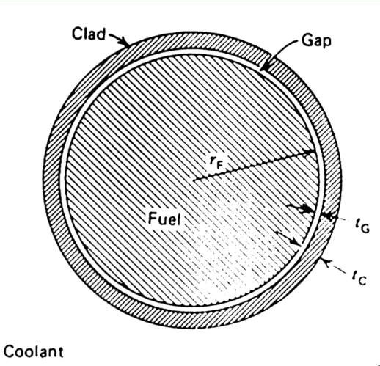
In order to solve, make assumptions!
#1: steady state ->
#2: axisymmetric ->
#3: constant in z
#4: constant thermal conductivity

Slide 7
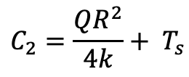
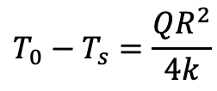
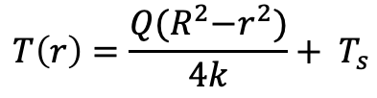
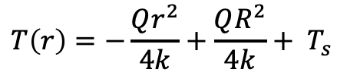
Directly Solving for Temperature Profile
Boundary conditions: r₀ = 0, r₁=R, T’(0) = 0, T(R) = T_{s}
r0
r1
$$C_{2}=\frac{QR^{2}}{4k}+ T_{s}$$
$$T\left(r\right)=−\frac{Qr^{2}}{4k}+\frac{QR^{2}}{4k}+ T_{s}$$
$$T\left(r\right)=\frac{Q{(R}^{2}−r^{2})}{4k}+ T_{s}$$
$$T_{0}−T_{s}=\frac{QR^{2}}{4k}$$

Slide 8
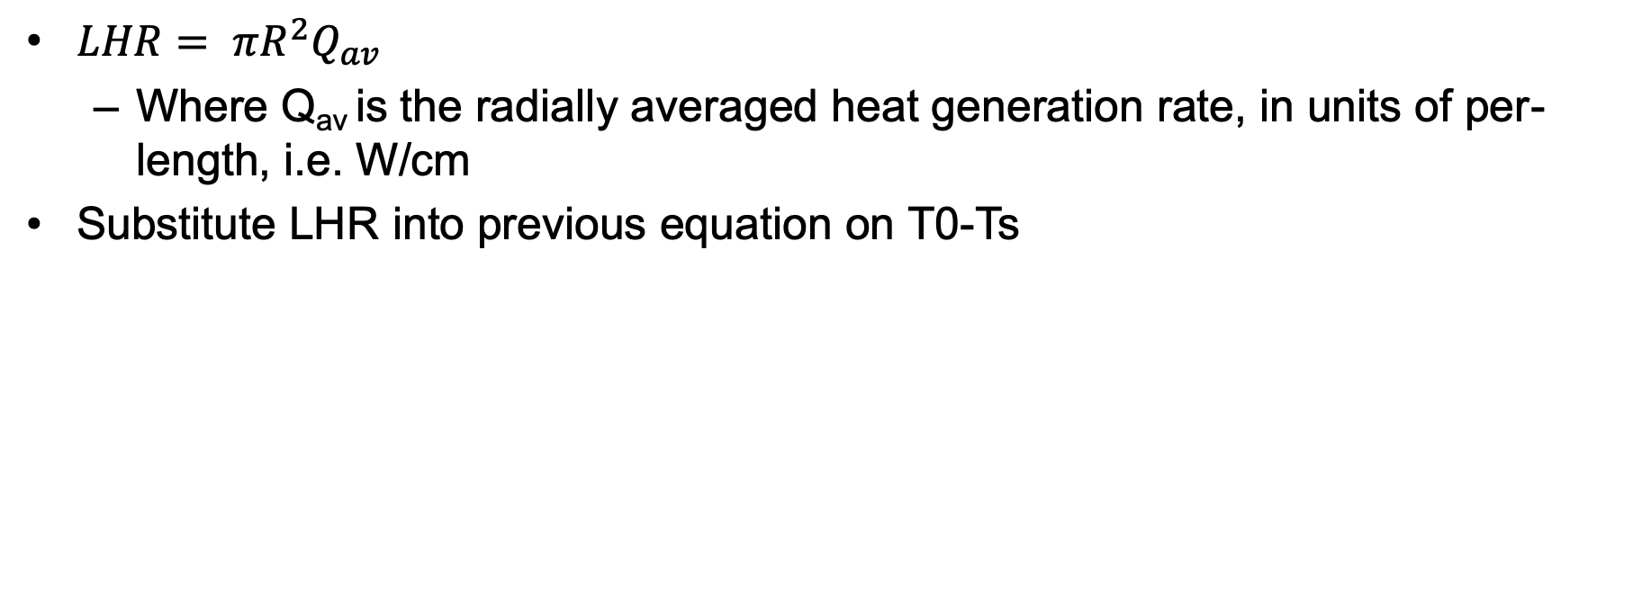
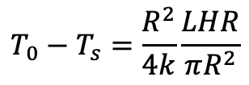
Linear Heat Rate
$LHR= πR^{2}Q_{av}$
Where Q_{av} is the radially averaged heat generation rate, in units of per-length, i.e. W/cm
Substitute LHR into previous equation on T0-Ts
$$T_{0}−T_{s}=\frac{R^{2}}{4k}\frac{LHR}{πR^{2}}$$

Slide 9
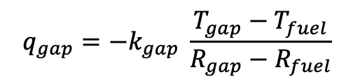
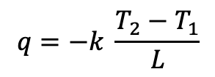
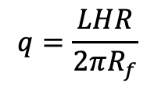
Heat transport through the gap
R₀=0
R₁=R_{f}
R₂=R_{IC}
The heat flux gives the rate, per unit area, at which heat flows in a given direction
The heat flux from the fuel is the LHR/pellet circumference
Heat flux from the fuel is the same as heat flux into the gap
Gap thickness = R_{IC}-R_{f} = t_{g}
Cladding thickness = R_{OC}-R_{IC} = t_{c}
$$q=−k \frac{T_{2}−T_{1}}{L}$$
$$q_{gap}=−k_{gap} \frac{T_{gap}−T_{fuel}}{R_{gap}−R_{fuel}}$$
$$q=\frac{LHR}{2πR_{f}}$$
R₃=R_{OC}

Slide 10
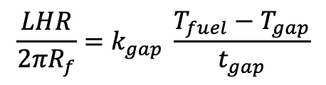
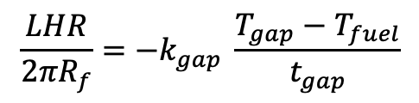
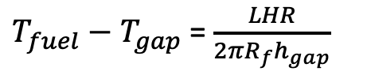
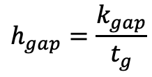
Heat transport through the gap
Set heat flux fuel/gap equal
Gap conductance is defined as:
Gap conductance depends on the gas filling the gap
For pure He, k_{gap}=16x10⁻⁶ * T^{0.79} (W/cm-K)
For pure Xe, k_{gap}=0.7x10⁻⁶ * T^{0.79} (W/cm-K)
Simple mixing rule: k_{gap} = k_{He}(1-y) + k_{Xe}y
Where y is the mole/atom fraction of Xe
$$\frac{LHR}{2πR_{f}}=−k_{gap} \frac{T_{gap}−T_{fuel}}{t_{gap}}$$
$$\frac{LHR}{2πR_{f}}=k_{gap} \frac{T_{fuel}−T_{gap}}{t_{gap}}$$
$$h_{gap}=\frac{k_{gap}}{t_{g}}$$
$T_{fuel}−T_{gap}$ = $\frac{LHR}{2πR_{f}h_{gap}}$

Slide 11
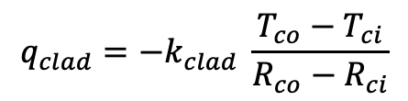
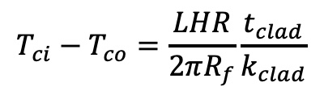
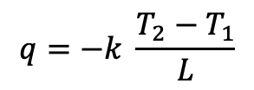
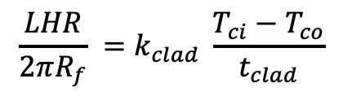
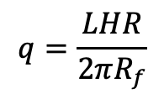
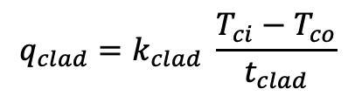
Heat transport through the cladding
$$q=−k \frac{T_{2}−T_{1}}{L}$$
$$q_{clad}=−k_{clad} \frac{T_{co}−T_{ci}}{R_{co}−R_{ci}}$$
Heat flux through the cladding
Set equal your heat fluxes
$$q=\frac{LHR}{2πR_{f}}$$
$$q_{clad}=k_{clad} \frac{T_{ci}−T_{co}}{t_{clad}}$$
$$\frac{LHR}{2πR_{f}} =k_{clad} \frac{T_{ci}−T_{co}}{t_{clad}}$$
$$T_{ci}−T_{co}=\frac{LHR}{2πR_{f}}\frac{t_{clad}}{k_{clad}}$$

Slide 12
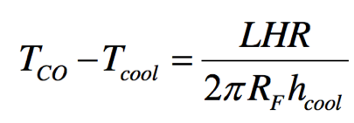
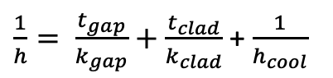
Heat transfer to the coolant
Heat is transported from the cladding to the coolant via convection
T_{cool} is the coolant temperature, h_{cool} is the convective heat transfer coefficient between cladding wall and coolant
Adding gap + cladding + coolant:
$\frac{1}{h}= \frac{t_{gap}}{k_{gap}}+$ $\frac{t_{clad}}{k_{clad}}$ + $\frac{1}{h_{cool}}$

Slide 13
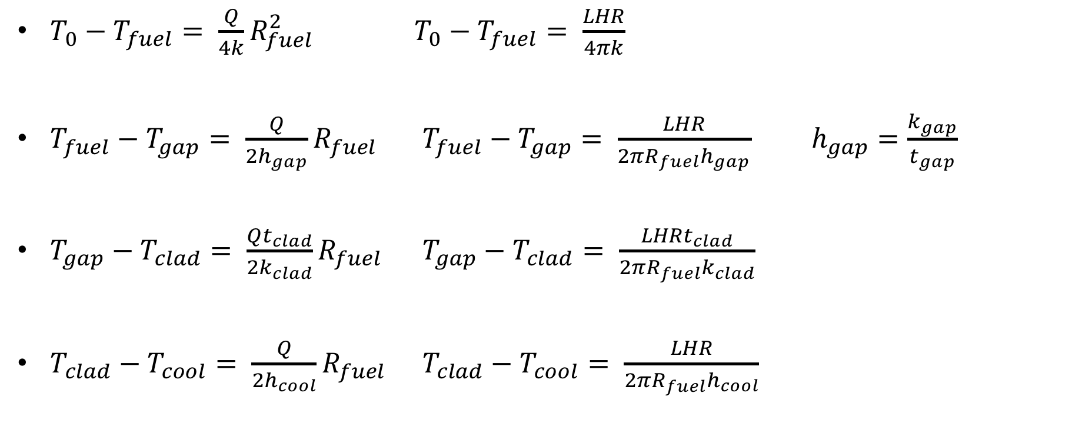
Summary of analytical solutions
$T_{0}−T_{fuel}= \frac{Q}{4k}R_{fuel}^{2}$ $T_{0}−T_{fuel}= \frac{LHR}{4πk}$
$T_{fuel}−T_{gap}= \frac{Q}{2h_{gap}}R_{fuel}$ $T_{fuel}−T_{gap}= \frac{LHR}{2{πR_{fuel}h}_{gap}}$ $h_{gap}=\frac{k_{gap}}{t_{gap}}$
$T_{gap}−T_{clad}= \frac{Qt_{clad}}{2k_{clad}}R_{fuel}$ $T_{gap}−T_{clad}= \frac{LHRt_{clad}}{2{πR_{fuel}k}_{clad}}$
$T_{clad}−T_{cool}= \frac{Q}{2h_{cool}}R_{fuel}$ $T_{clad}−T_{cool}= \frac{LHR}{2{πR_{fuel}h}_{cool}}$
T_{gap} = T_{CI} (clad inner)
T_{clad} = T_{CO} (clad outer)

Slide 14
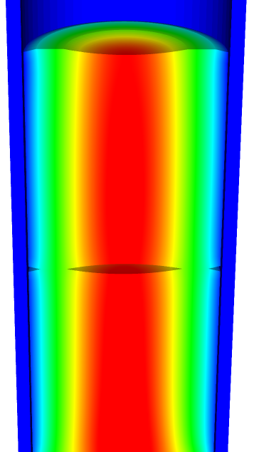
Solving for the temperature profile
T_{CO} T_{CI}
You first solve for the transition temperatures.
Start from the coolant and work inward
Then, assume a linear profile everywhere except in the fuel
Finally, solve for the temperature profile throughout the fuel
T_{cool}

Slide 15
Fuel and Cladding Thermal Properties
Material | Density (g/cm³) | Heat Capacity Cp (J/g-K) | Thermal Conductivity k (W/cm-K) | Thermal Expansion Coefficient a (K⁻¹)
UO₂ | 10.98 | 0.33 | 0.03 | 1.2 x 10⁻⁵
Zr | 6.5 | 0.35 | 0.17 | 1.0 x 10⁻⁵
Stainless steel | 8.0 | 0.5 | 0.17 | 9.6 x 10⁻⁶

Slide 16
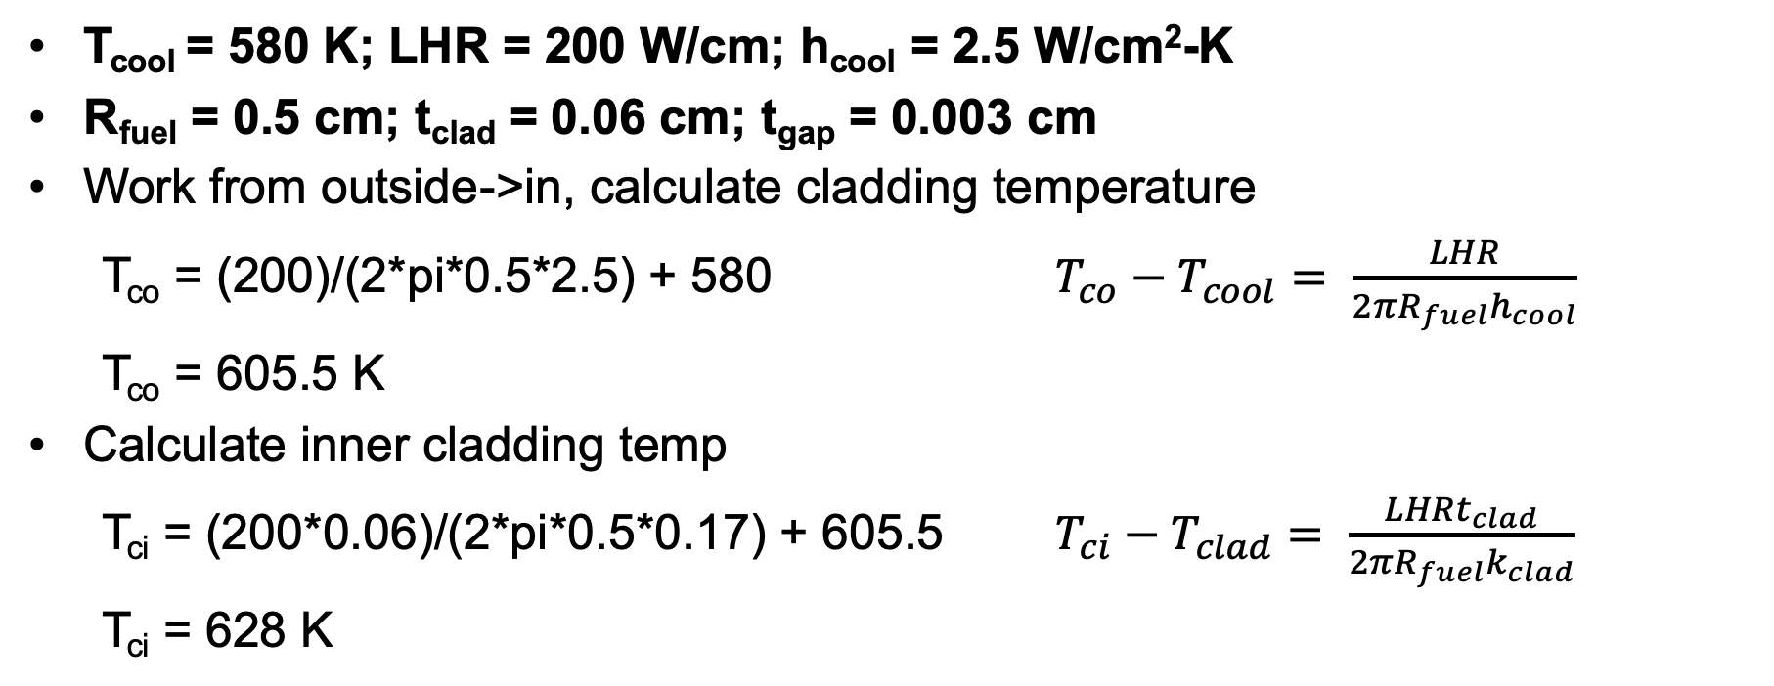
Temperature profile calculation example
T_{cool} = 580 K; LHR = 200 W/cm; h_{cool} = 2.5 W/cm²-K
R_{fuel} = 0.5 cm; t_{clad} = 0.06 cm; t_{gap} = 0.003 cm
Work from outside->in, calculate cladding temperature
T_{co} = (200)/(2*pi*0.5*2.5) + 580 $T_{co}−T_{cool}= \frac{LHR}{2{πR_{fuel}h}_{cool}}$
T_{co} = 605.5 K
Calculate inner cladding temp
T_{ci} = (200*0.06)/(2*pi*0.5*0.17) + 605.5 $T_{ci}−T_{clad}= \frac{LHRt_{clad}}{2{πR_{fuel}k}_{clad}}$
T_{ci} = 628 K

Slide 17
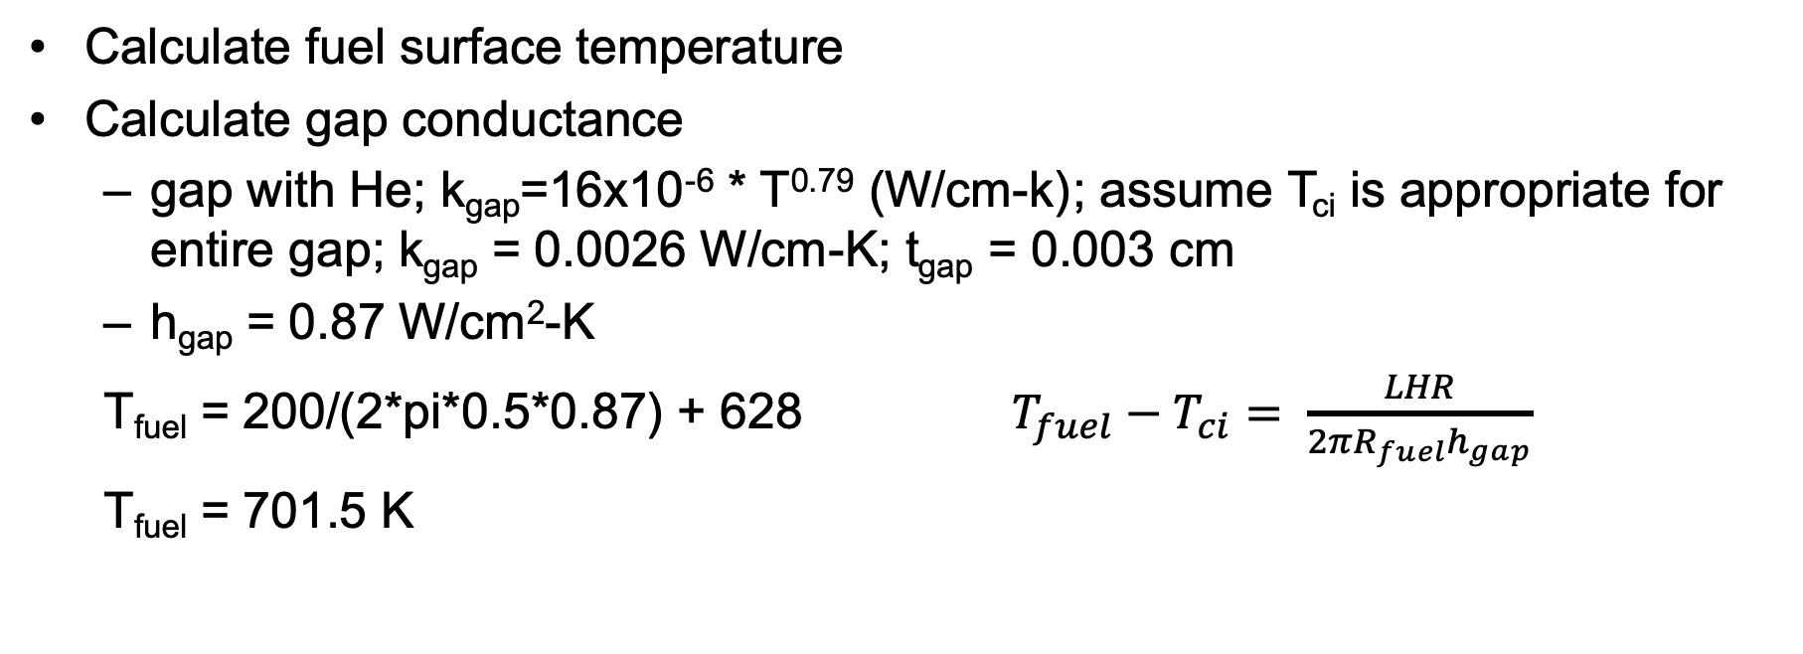
Temperature profile calculation example
Calculate fuel surface temperature
Calculate gap conductance
gap with He; k_{gap}=16x10⁻⁶ * T^{0.79} (W/cm-k) ; assume T_{ci} is appropriate for entire gap; k_{gap} = 0.0026 W/cm-K; t_{gap} = 0.003 cm
h_{gap} = 0.87 W/cm²-K
T_{fuel} = 200/(2*pi*0.5*0.87) + 628 $T_{fuel}−T_{ci}= \frac{LHR}{2{πR_{fuel}h}_{gap}}$
T_{fuel} = 701.5 K

Slide 18
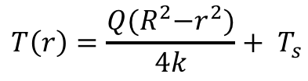
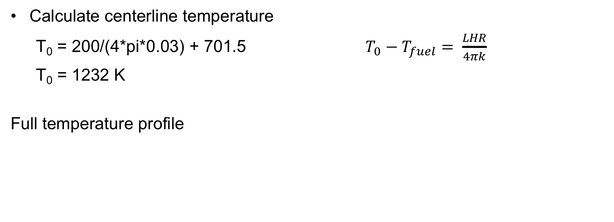
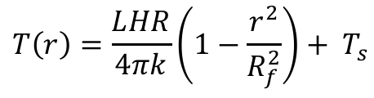
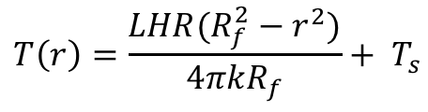
Temperature profile calculation example
Calculate centerline temperature
T₀ = 200/(4*pi*0.03) + 701.5 $T_{0}−T_{fuel}= \frac{LHR}{4πk}$
T₀ = 1232 K
Full temperature profile
$$T\left(r\right)=\frac{Q{(R}^{2}−r^{2})}{4k}+ T_{s}$$
$$T\left(r\right)=\frac{LHR(R_{f}^{2}−r^{2})}{4πkR_{f}}+ T_{s}$$
$$T\left(r\right)=\frac{LHR}{4πk}\left(1−\frac{r^{2}}{R_{f}^{2}}\right)+ T_{s}$$

Slide 19
Temperature profile calculation example
Parabolic temperature profile in fuel
Linear in gap and clad
Steep temperature drop over gap, very low thermal conductivity
Smaller temperature drop over cladding

Slide 20
Temperature profile modification
Instead of pure He gap, 30% of gas is Xe; how is T₀ affected?
First, how is gap conductance affected?
Gap conductance depends on the gas filling the gap
For pure He, k_{gap}=16x10⁻⁶ * T^{0.79} (W/cm-K)
For pure Xe, k_{gap}=0.7x10⁻⁶ * T^{0.79} (W/cm-K)
Simple mixing rule: k_{gap} = k_{He}(1-y) + k_{Xe}y
T_{CI}, T_{CO}, and T_{cool} is unchanged from previous example, also T₀-T_{fuel} is unchanged
k_{gap} = ((16x10⁻⁶)*(628)^{0.79} )(1-0.3) + ((0.7x10⁻⁶)*(628)^{0.79} )(0.3) = 1.85E-3 W/cm-K

Slide 21
Temperature profile modification
k_{gap} = 1.85E-3 W/cm-K
h_{gap} = 1.85E-3 / 0.003 = 0.62 W/cm²-K
T_{fuel} = 200/(2*pi*0.5*0.62) + 628 = 731 K
T₀ – T_{fuel} = 530.5 K (unchanged from before)
T₀ = 731 + 530.5 = 1261.6 K
Increase in T₀ of 30 K
Caveat: linear mixing of gases is not the best approach

Slide 22
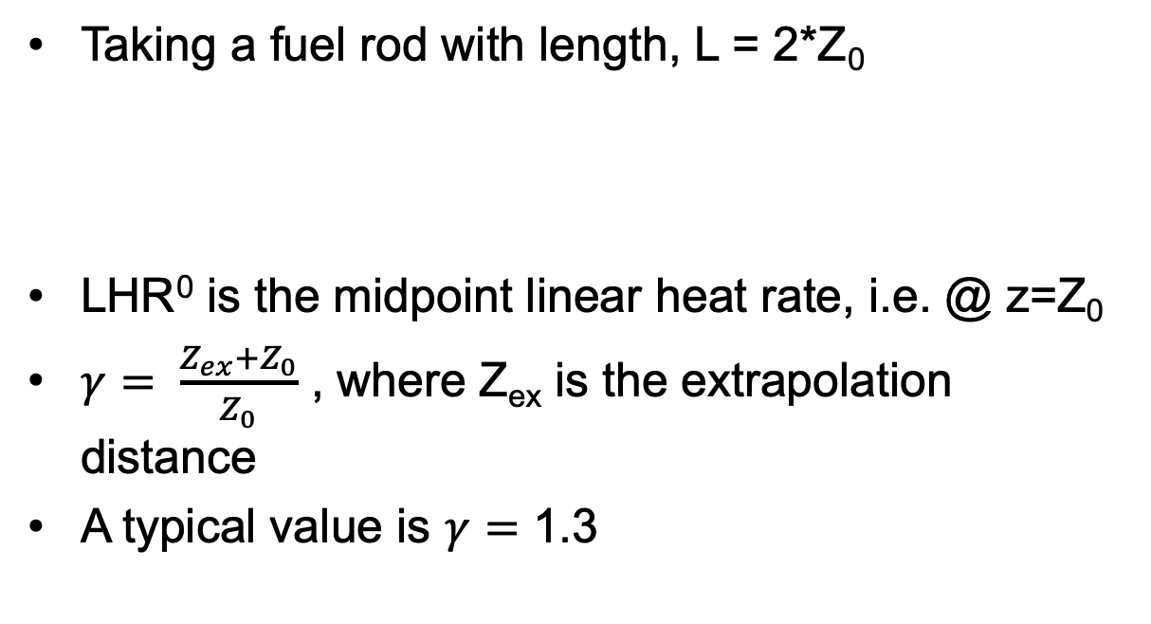
Neutron flux varies axially, so does LHR
Taking a fuel rod with length, L = 2*Z₀
LHR⁰ is the midpoint linear heat rate, i.e. @ z=Z₀
$γ= \frac{Z_{ex}+Z_{0}}{Z_{0}}$ , where Z_{ex} is the extrapolation distance
A typical value is $γ=$ 1.3

Slide 23
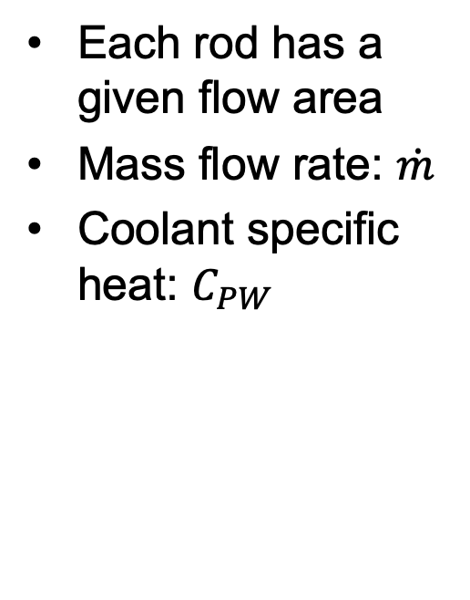
Coolant temperature varies with Z
Each rod has a given flow area
Mass flow rate: $\dot{m}$
Coolant specific heat: $C_{PW}$

Slide 24
Calculate LHR and T_{cool} with axial variation
mdot = 0.25 kg/s-rod; Z₀ = 150 cm; LHR⁰ = 150 W/cm; C_{PW} = 4200 J/kg-K; T_{in}= 570 K

Slide 25
Summary
Developed analytical expressions for the temperature profile within a fuel rod
Required to make four assumptions:
Steady-state solution
Temperature is axisymmetric
T is constant in Z
Thermal conductivity is independent of temperature
Temperature profile in the fuel is parabolic, assume linear profiles in gap, clad and coolant
Can incorporate axial variation in T_{cool} with axial variation in LHR

Slide 26
Numerical time integration

Slide 27
For numerical solutions, deal with derivatives in space/time
Derivatives in time
Forward Euler’s method (explicit)
Backward Euler’s method (implicit)
Derivatives in space
Finite difference
Finite volume
Finite element

Slide 28
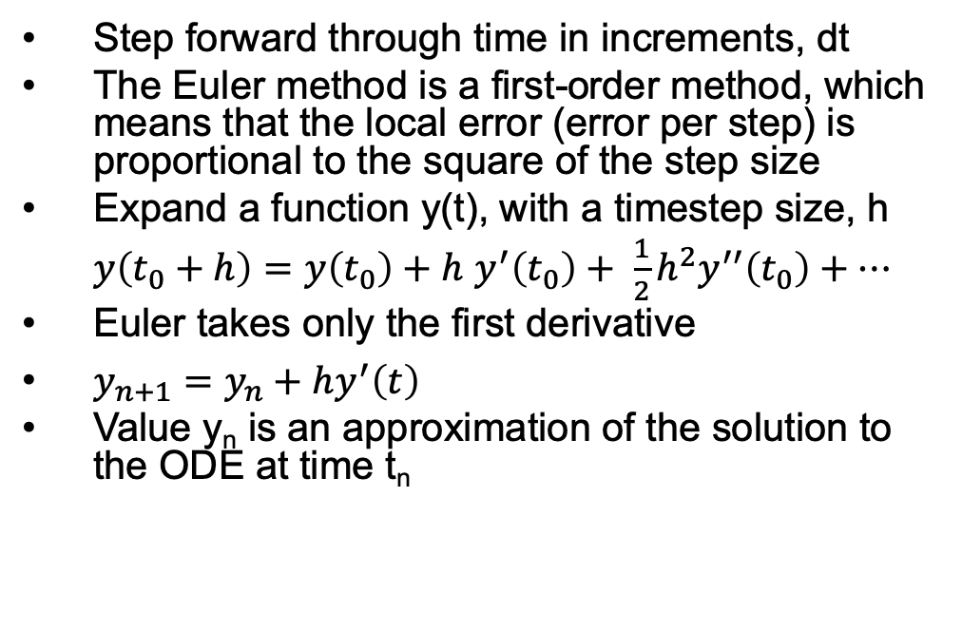
Forward Euler
Step forward through time in increments, dt
The Euler method is a first-order method, which means that the local error (error per step) is proportional to the square of the step size
Expand a function y(t), with a timestep size, h
$y\left(t_{0}+h\right)=y\left(t_{0}\right)+h$ $y^{′}\left(t_{0}\right)+ \frac{1}{2}h^{2}y^{′′}\left(t_{0}\right)+…$
Euler takes only the first derivative
$y_{n+1}=y_{n}+hy^{′}\left(t\right)$
Value y_{n} is an approximation of the solution to the ODE at time t_{n}

Slide 29
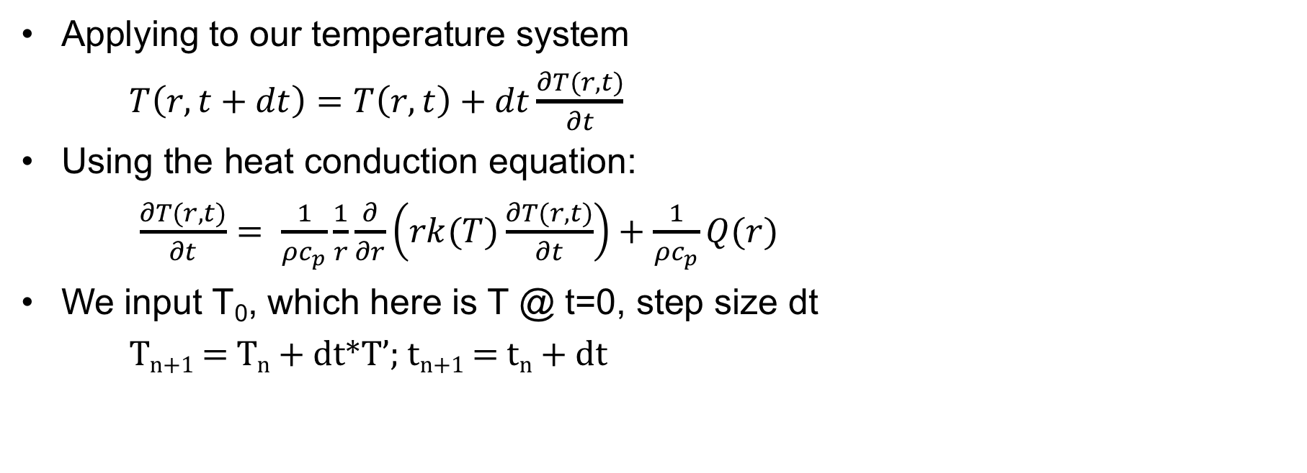
Forward Euler
Applying to our temperature system
$T\left(r,t+dt\right)=T\left(r,t\right)+dt\frac{∂T(r,t)}{∂t}$
Using the heat conduction equation:
$\frac{∂T(r,t)}{∂t}= \frac{1}{ρc_{p}}\frac{1}{r}\frac{∂}{∂r}\left(rk(T)\frac{∂T(r,t)}{∂t}\right)+\frac{1}{ρc_{p}}Q(r)$
We input T₀, which here is T @ t=0, step size dt
T_{n+1} = T_{n} + dt*T’; t_{n+1} = t_{n} + dt
T
t

Slide 30
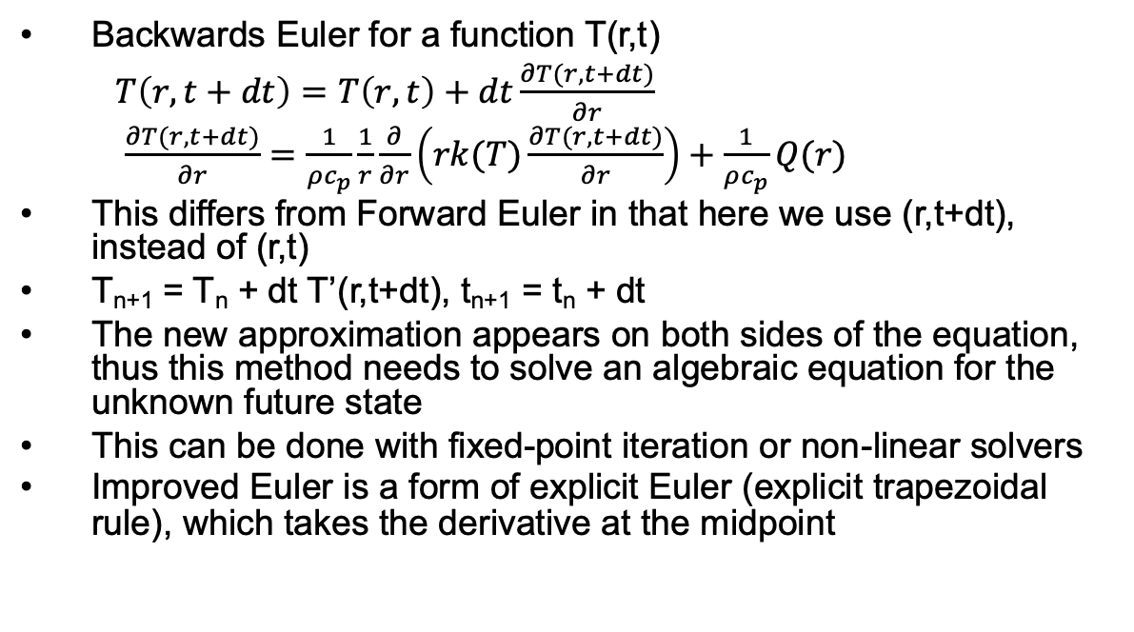
Backwards Euler
Backwards Euler for a function T(r,t)
$T\left(r,t+dt\right)=T\left(r,t\right)+dt\frac{∂T(r,t+dt)}{∂r}$
$\frac{∂T(r,t+dt)}{∂r}=\frac{1}{ρc_{p}}\frac{1}{r}\frac{∂}{∂r}\left(rk(T)\frac{∂T(r,t+dt)}{∂r}\right)+\frac{1}{ρc_{p}}Q(r)$
This differs from Forward Euler in that here we use (r,t+dt), instead of (r,t)
T_{n+1} = T_{n} + dt T’(r,t+dt), t_{n+1} = t_{n} + dt
The new approximation appears on both sides of the equation, thus this method needs to solve an algebraic equation for the unknown future state
This can be done with fixed-point iteration or non-linear solvers
Improved Euler is a form of explicit Euler (explicit trapezoidal rule), which takes the derivative at the midpoint
T
t

Slide 31
Explicit vs Implicit
Forward Euler is explicit
Explicit methods calculate the state of a system at a later time from the state of the system at the current time
Can be unstable if step size is too much
Backwards Euler is implicit
Implicit methods find a solution by solving an equation involving both the current state of the system and a later state
Implicit require an extra computation and they can be much harder to implement
Implicit methods are used because many problems arising in practice are stiff, for which the use of an explicit method requires very small timesteps

